Slide 1
GROUP 1
CLIENT SERVER JAVA SYSTEM

Slide 2
GROUP 1 GOALS
Apply all the knowledge that was taught.
We don’t see any reasons to apply advance java concepts like swing.
To be able to present a high quality project.
To rotate tasks allocations.

Slide 3
Project Approach
Brainstorm
Members have given their inputs about the system that will be created.
Team separation
Programmers and UML designers
After the UML designers finished their side, they where able to help the programmers.

Slide 4
Work Allocation
Programmers
John Paul Limos – Client Server
Ana Katrina De Leon – Client Server
Paulin Joyce Racelis - DBConnection
UML Designers
Aljun Dequilla - Use Case
Mark Anthony Andes - Sequence
Leader
Allocates task to members
See the whole picture of the system
Consultant (Programming/UML)
Help members.

Slide 5
UML

Slide 6
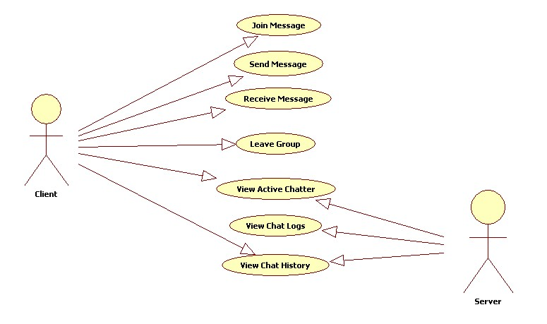

Slide 7
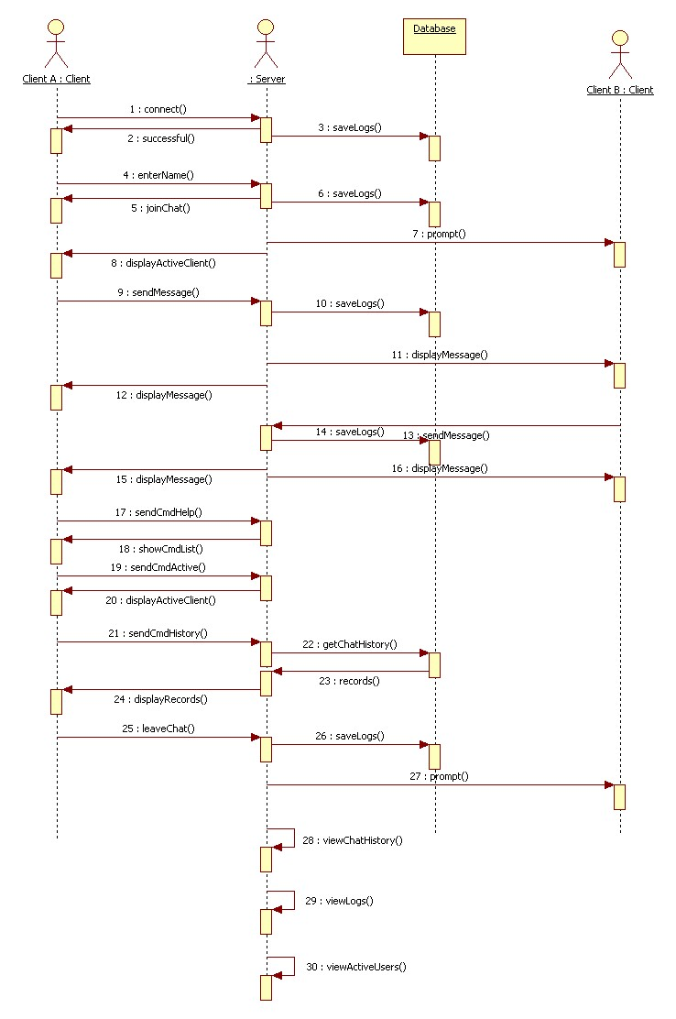

Slide 8
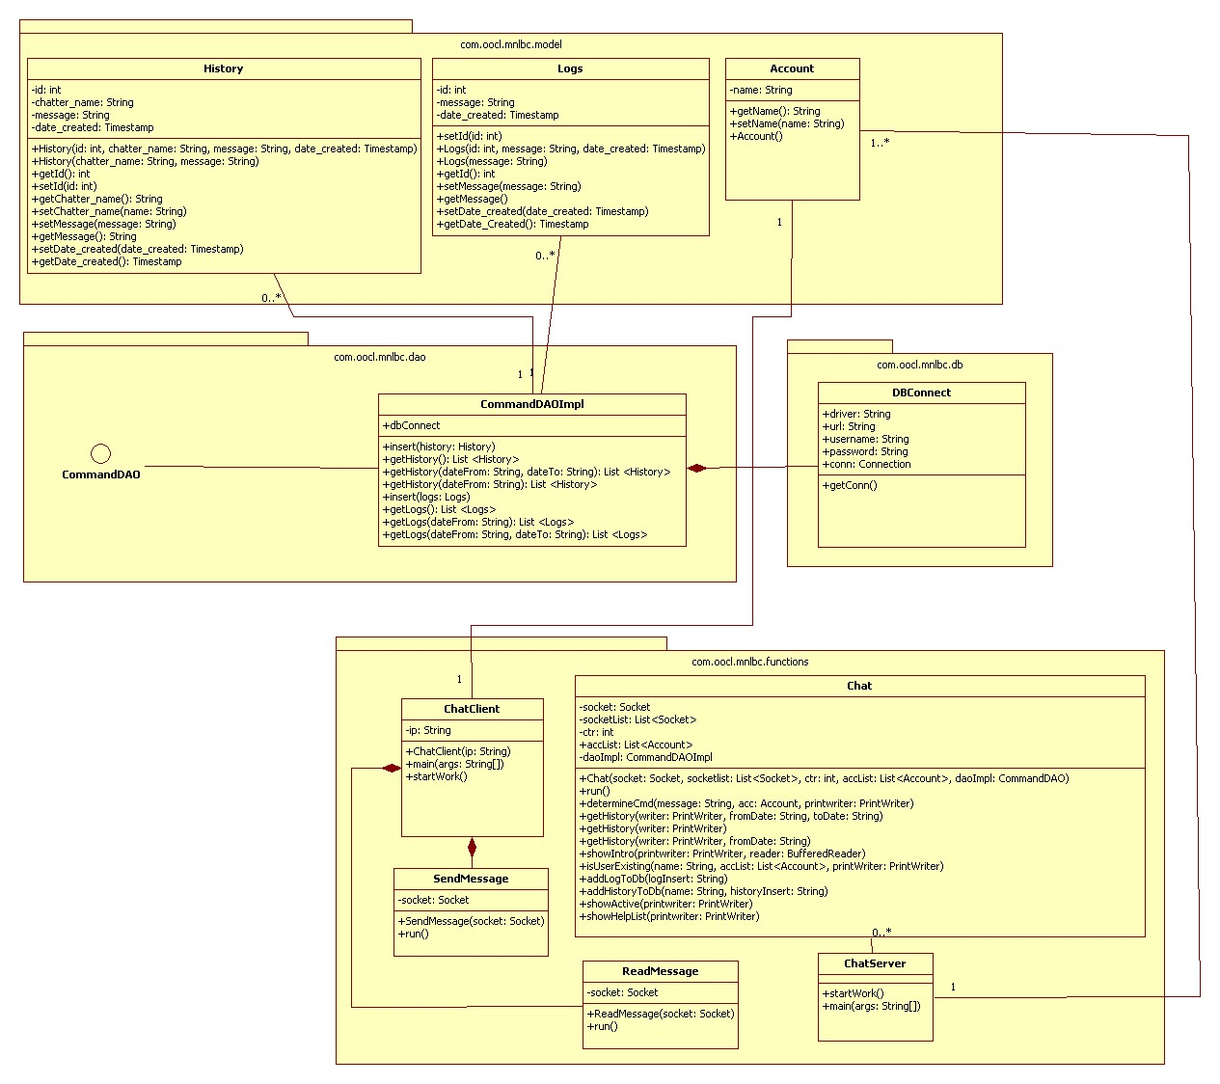

Slide 9
Java

Slide 10
Implemented Concept in the System
Basic OOP concepts.
Encapsulation
Reflection
Junit Test Case
Java Documentation
Threading
JDBC
FileWrite

